Slide 1

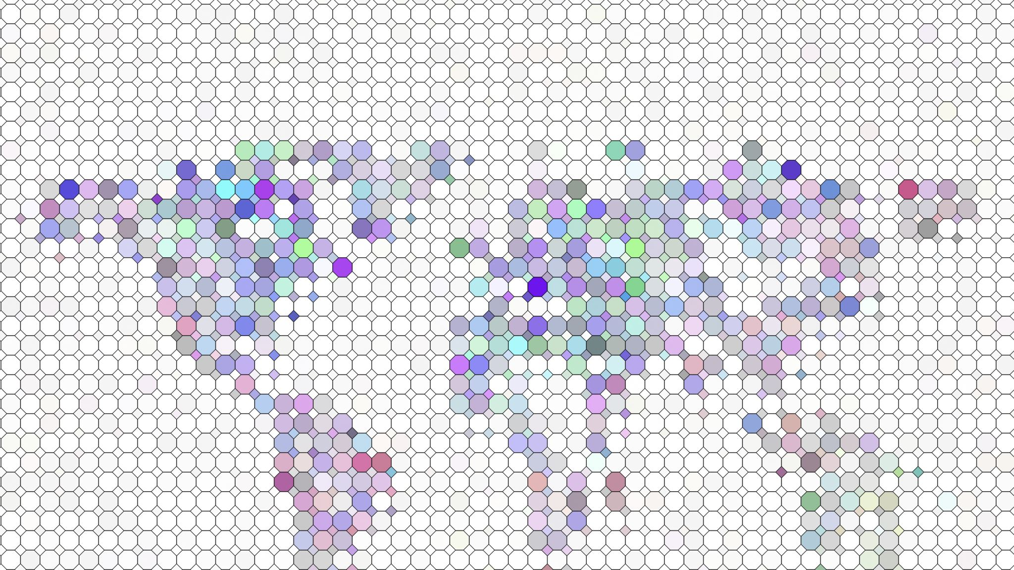
Rockbuster Stealth Data Analysis

Slide 2

Introduction
We will take a look at the statistical analysis of different areas in the film table
Break down of the max, min, average and mode for rental duration, rental rate, film length, and replacement cost.
For the rating, looked at the mode only
We will look into the top results for:
Top 10 countries with the most customers
Top 10 cities of those 10 countries
Top 5 customers that spent the most total

Slide 3
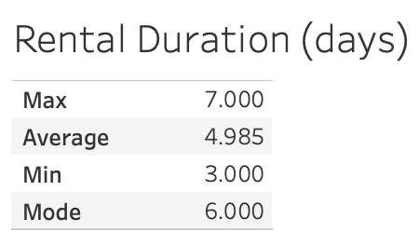
Statistical Analysis – Rental Duration
Figure 1: Out of 1,000 data points, the above figure shows the max at 7 days, the min at 3 days, the average at 4.985 days and the mode of 6 days for rental duration Tableau Link

Slide 4
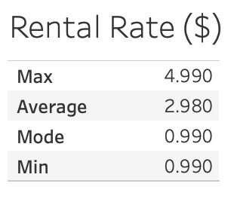
Statistical Analysis – Rental Rate
Figure 2: Out of 1,000 data points, the above figure shows the max at $4.99, the min at $0.99, the average at $2.98 and the mode of $0.99 for rental rate Tableau Link

Slide 5
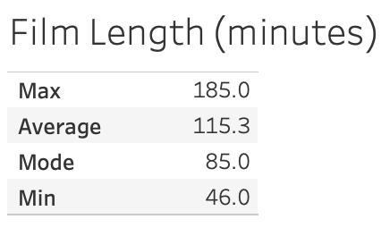
Statistical Analysis – Film Length
Figure 3: Out of 1,000 data points, the above figure shows the max at 185 minutes, the min at 46 minutes, the average at 115.3 minutes and the mode of 85 minutes for film length Tableau Link

Slide 6
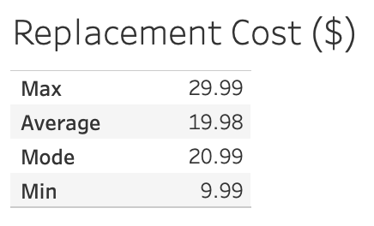
Statistical Analysis – Replacement Cost
Figure 4: Out of 1,000 data points, the above figure shows the max at $29.99, the min at $9.99, the average at $19.98 and the mode of $20.99 for replacement cost Tableau Link

Slide 7
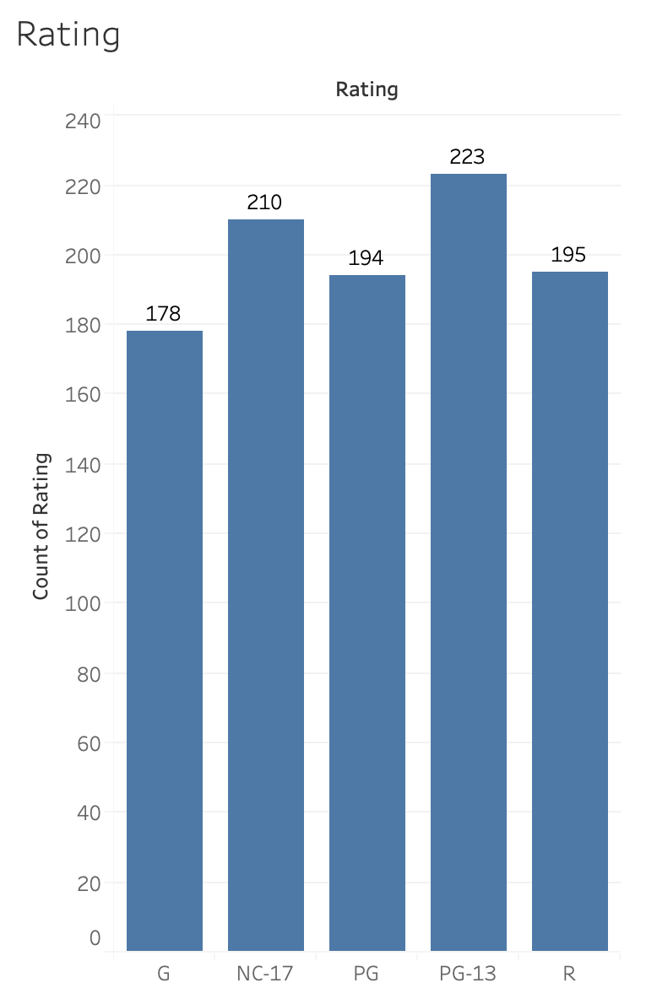
Statistical Analysis – Rating
Figure 5: Out of 1,000 data points, since there is no way to find a min and max for the rating table, the mode tells us that the most films Rockbuster stores is for the PG-13 rating. Tableau Link

Slide 8
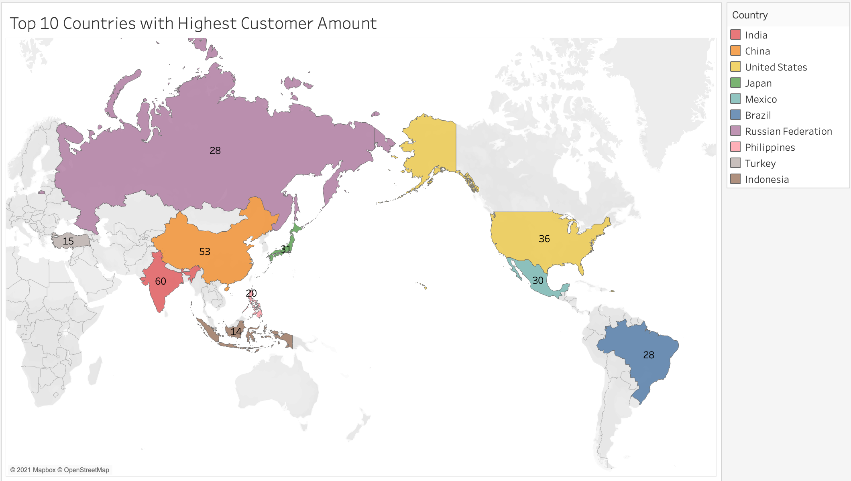
Top 10 Countries with Highest Customers
Figure 6: Shows the top 10 countries with the most customers. India is the highest with 60 customers, and Indonesia is the lowest with 14. Tableau Link

Slide 9
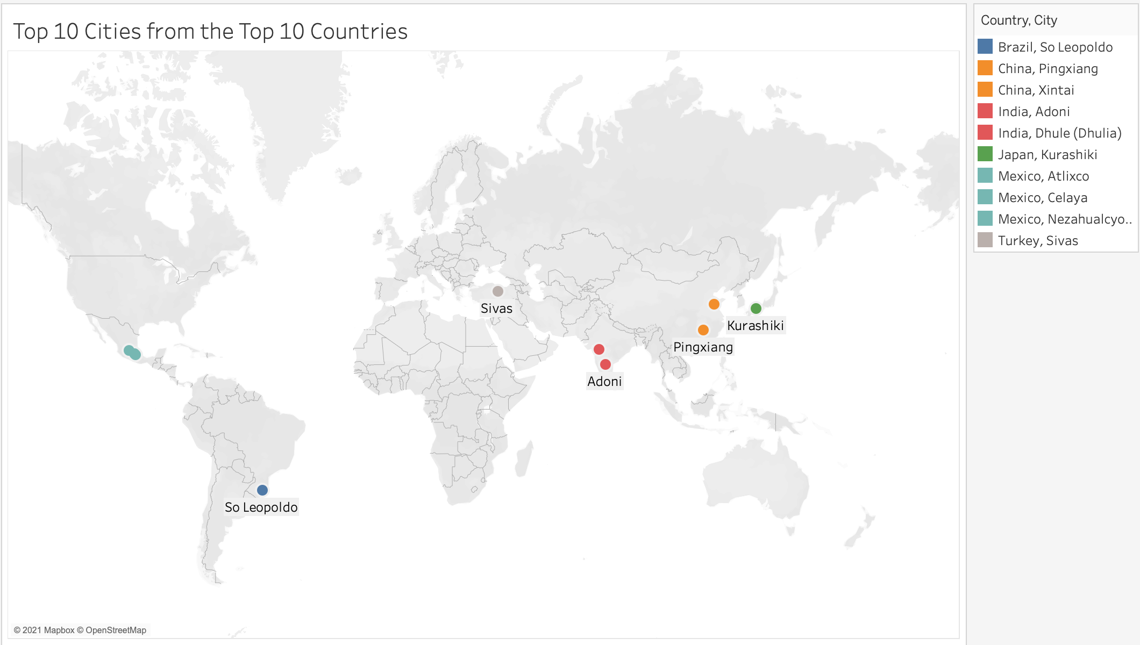
Top 10 Cities from Top 10 Countries
Figure 7: Shows the top 10 cities from the top 10 countries with the most customers. Tableau Link

Slide 10
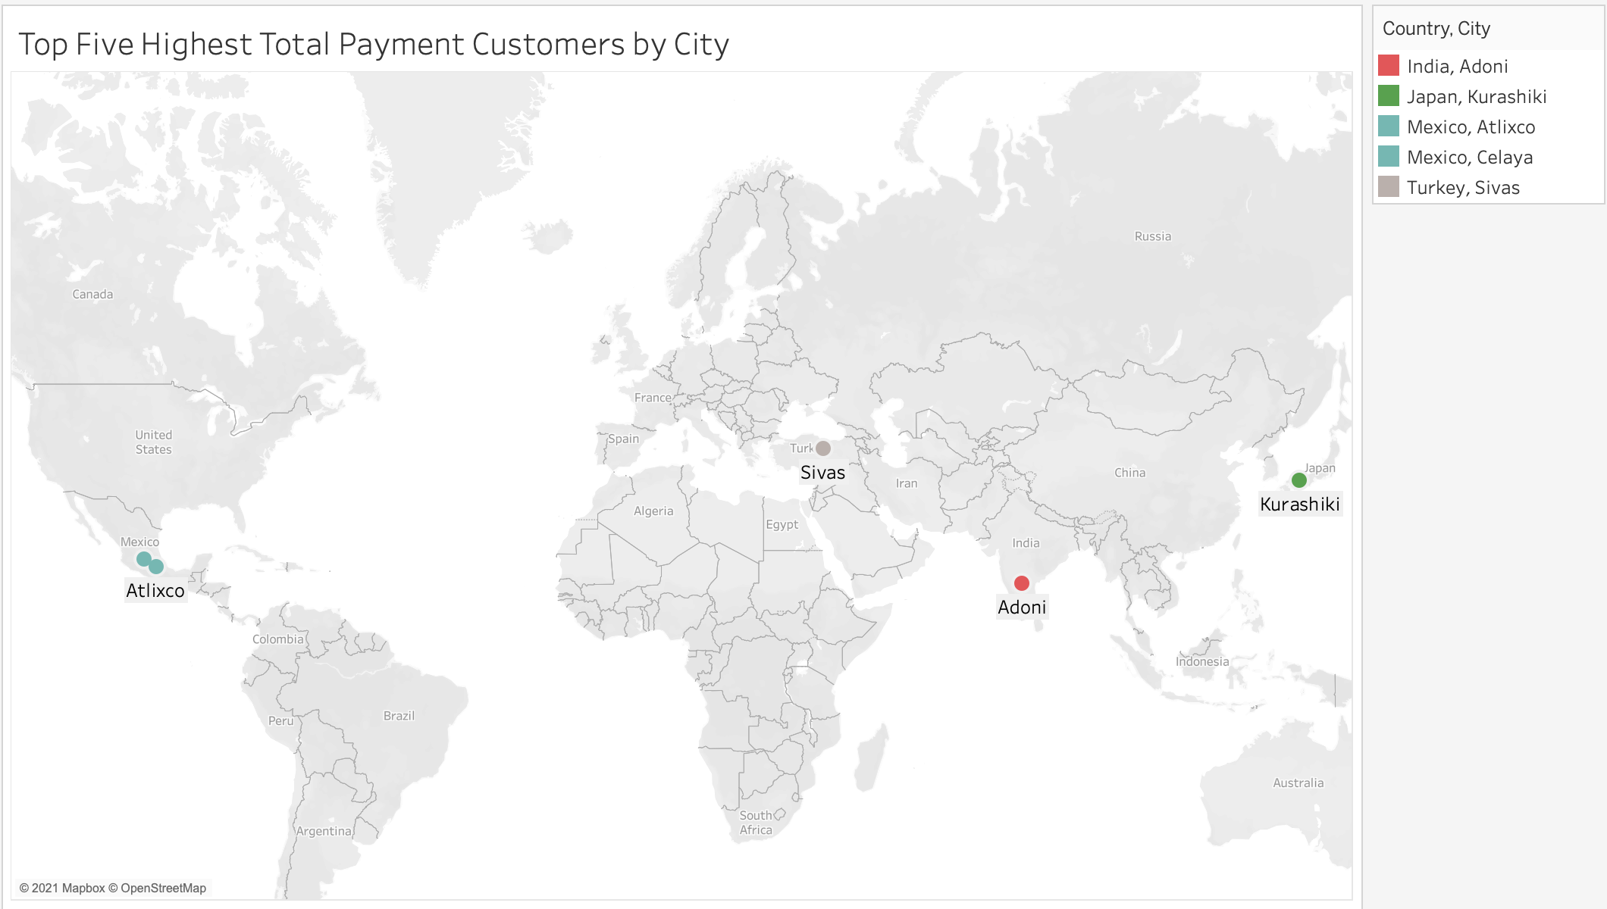
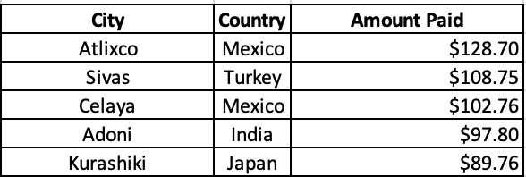
Top 5 Customers Spending the Highest Total Payments
Figure 8: To the right, shows the cities that the top 5 customers who spent the most in payments to Rockbuster. Tableau Link
Figure 9: Below, shows the amount spent that the top 5 customers paid

Slide 11
Recommendations
Using the Top 10 countries – Rockbuster can prioritize those to try and grow profit or prioritize countries outside of the Top 10 to grow profit
Can look into the top cities for not only just the Top 10 countries but many others to see which cities are doing well and which cities need more marketing
Need to deep dive into what the Top 5 customers are spending money on, is it replacement costs or rentals?
Not only just the Top 5 customers, but what are the Top 20 customers spending their money on?
Should look into genres of films that customers are spending money on, what seems to be the most or least popular?
May want to get customer feedback to see what areas need improvement or are doing great

